Slide 1

How to Be the Boss of Your AI Assistant
Understanding LLMs & The Research Workflow Michael Borck

Slide 2
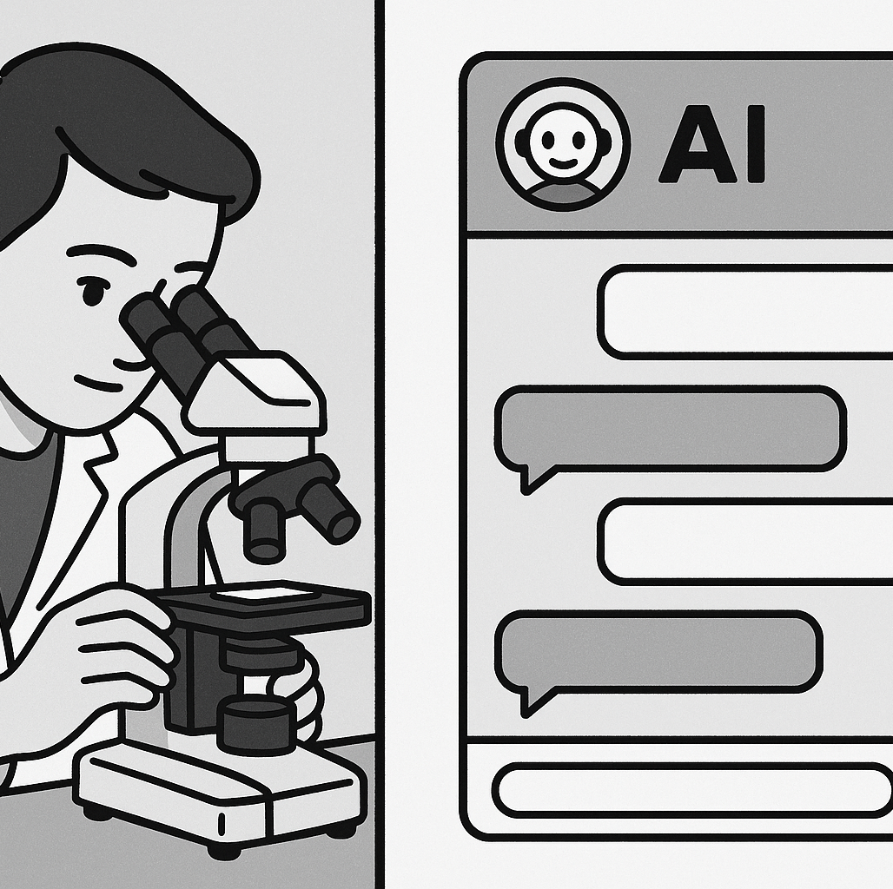
Welcome!
Today’s Journey
Understanding your AI assistant
Why structure beats magic
A proven 10-step research workflow
Live demonstration
Your roadmap to AI-powered research
Notes:
Welcome students. Today we’re learning how to effectively manage AI tools for research. This isn’t about fancy prompts - it’s about understanding how these tools work.

Slide 3
Quick System Check! 📋
Do you have access to:
✅ Microsoft Copilot (copilot.microsoft.com)
✅ Internet connection
✅ Ability to download files
Can’t Access Copilot?
Try ChatGPT (chat.openai.com) - free tier works
Claude (claude.ai) - also free
Key point: The principles work with ANY AI assistant
Timing: We’ll have troubleshooting breaks at 15 and 35 minutes!​

Slide 4
The Problem: The “Everything” Prompt
Have you ever tried this?
You ask AI to do a huge task all at once…
“Analyse high-pressure processing for juice shelf life, tell me pros and cons, design an experiment for Vitamin C in orange juice, write the methods, and create expected results table”

Slide 5
What do you get back? 😕
❌ Shallow, generic summary
❌ Forgets half your instructions
❌ Messy, unusable output
Real Example: “Write my entire literature review on plant proteins” → Gets 2 paragraphs of Wikipedia-level content
Notes:
This happens because you’re giving the AI too much to think about at once. It’s like asking someone to juggle while solving math problems.

Slide 6

The Solution: Think Like a Manager
Not a Magician! ✨
Big Idea: Break complex research into small, logical steps
The Golden Rule - One Task, One Prompt
Give your AI assistant one clear job at a time
Let’s explore why this simple rule is so powerful…

Slide 7
Quick Start Essentials
The Most Important Prompt Template:
You are an AI research scientist specializing in [YOUR FIELD]. Task: [ONE SPECIFIC TASK] Requirements: - [SPECIFIC REQUIREMENT 1] - [SPECIFIC REQUIREMENT 2] - [SPECIFIC REQUIREMENT 3] Format: [HOW YOU WANT THE OUTPUT] Context: [BACKGROUND INFO IF NEEDED]
Notes:
Save this! 80% of your AI interactions will use this basic structure

Slide 8
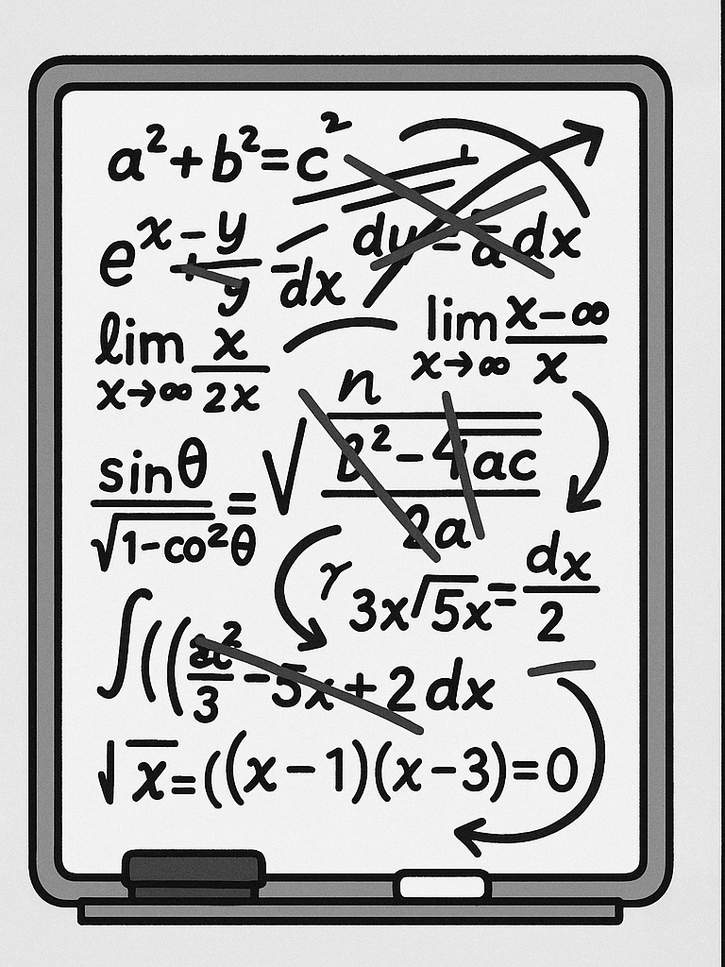
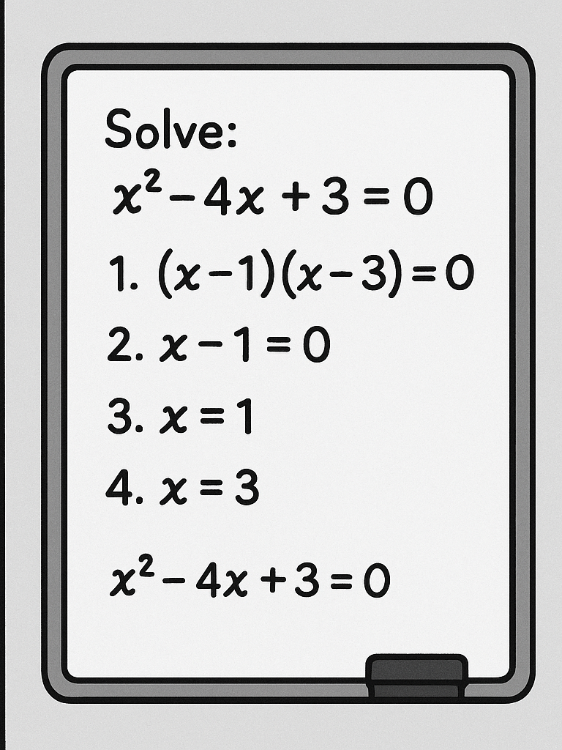
Reason 1: Limited “Working Memory” 🧠
❌ The “Everything” Prompt
✅ The Step-by-Step Approach
Takeaway: A single, focused task gets the AI’s full attention​

Slide 9
Technical Detail: Context Windows
What’s really happening?
LLMs have finite context windows (8k-200k tokens)
Token ≈ 0.75 words
Each task competes for this limited space
Example:
LLM Context window: ~8,000 tokens
Complex research prompt: ~500 tokens
Response space needed: ~1,500 tokens per task
Result: Only 3-4 tasks fit properly!
Think of it like RAM: Too many programs = computer slows down. Too many tasks = AI quality drops.
Notes:
This is why breaking tasks down isn’t just helpful - it’s technically necessary for quality outputs.

Slide 10
Reason 2: Guiding the AI’s “Thinking”
LLMs Create Answers Piece by Piece
Each word depends on previous words
Complex prompts = mental shortcuts
Structured prompts = logical reasoning
Cooking Analogy 👨‍🍳
❌ Bad: “Make beef wellington”
Chef might skip steps or use wrong ingredients
✅ Good: 1. “First, sear the beef” 2. “Next, prepare duxelles” 3. “Then, wrap in pastry”
Notes:
By giving step-by-step instructions, you force the AI to build a logical argument, leading to much stronger outputs.

Slide 11
Reason 3: Easy Error Detection & Fixing
With a Giant Prompt
Problem: Weak experimental method
Solution: Re-run EVERYTHING
Time lost: 10-15 minutes
Quality: Hope for the best 🤞
With Our Workflow
Problem: Weak experimentalmethod
Solution: Fix just that step
Time lost: 2 minutes
Quality: Keep what works ✓
Takeaway: A single, focused task gets the AI’s full attention

Slide 12
Reason 4: More and Better Ideas
Diversity vs. Convergence
❌ Single Prompt Approach
“Give me the best hypothesis for oat milk fermentation” → One idea, possibly mediocre
✅ Our Multi-Step Approach
Generate: “Give me 5 hypotheses” → Diversity
Evaluate: “Score each for feasibility” → Analysis
Select: “Recommend the top 3” → Quality
Result: Multiple perspectives + Critical evaluation = Stronger research

Slide 13
Success Metrics
Good AI Outputs Look Like This:​
✅ Structure & Detail
- Organized sections
- Specific numbers/examples
- Academic language
- Proper formatting
✅ Actionable Content
- Clear next steps
- Testable hypotheses
- Realistic timelines
- Measurable outcomes
Bad AI Outputs Look Like This:​
❌ Vague & Generic
- “Consider various factors…”
- “This is an important topic…”
- “Results may vary…”
❌ Incomplete
- Missing key sections
- No specific examples
- Unclear methodology

Slide 14
The 10-Step Research Workflow 🔬
Discovery Phase (Steps 1-5)
1. Idea Generation - Brainstorm hypotheses
2. Parallel Exploration - Diversify ideas
3. Preliminary Testing - Feasibility checks
4. Optimisation - Find best parameters
5. Full Execution - Main study design

Slide 15
The 10-Step Research Workflow (cont’d) 📝
Communication Phase (Steps 6-10)
Component Analysis - What matters most?
Visualization - Create figures & charts
Writing - Draft manuscript
Review - Peer review simulation
Iteration - Continuous improvement
This mirrors the actual scientific method - we’re just using AI as our assistant!

Slide 16
Step 1: Idea Generation 🌱
The Power of Structured Brainstorming
Prompt Template:
You are an AI research scientist specializing in Food Science. Given the following research area, generate 5 distinct and innovative scientific hypotheses suitable for a Masters-level research paper. For each hypothesis, include: - A clear Title - 3-5 Keywords - A short Abstract (under 200 words) - An explanation of its Novelty and Significance Research Area: [YOUR TOPIC HERE]
Pro tip: Replace “Food Science” with your specific field for better results!
Notes:
Notice how specific this prompt is. We’re not just asking for “ideas” - we’re asking for structured, academic hypotheses.

Slide 17
Step 2-3: Exploration & Feasibility 🔍
Step 2: Parallel Exploration (12 min)
Open multiple chat sessions
Generate non-overlapping ideas
Score and rank all options
Output: 10-15 diverse hypotheses
Step 3: Preliminary Testing (10 min)
Select top hypothesis
Design minimal experiment
Generate expected data
Output: Feasibility confirmed
Key insight: Step 2 prevents tunnel vision - you see ALL possibilities before committing!​

Slide 18
Steps 4-6: The Research Core 🔬
Building Your Study
Step 4: Optimization (15 min) - Test variable combinations - Define success criteria - Find the “sweet spot”
Step 5: Full Execution (15 min) - Detailed methodology - Comprehensive data tables - Statistical measures
Step 6: Component Analysis (8 min) - What ingredients matter? - Ablation studies - Understanding mechanisms

Slide 19
Steps 7-10: Communication & Refinement 📊
Step 7: Visualization (10 min) - Generate scientific figures - Write clear captions - Visual storytelling
Step 8: Manuscript Writing (12 min) - Complete paper draft - All sections included - Proper citations
Step 9: Peer Review (5 min) - Critical evaluation - Scoring rubric - Actionable feedback
Step 10: Iteration (5 min) - Address weaknesses - Refine sections - Achieve excellence

Slide 20
The Complete Workflow
Step | Task | Output
1 | Idea Generation | 5 hypotheses table
2 | Parallel Exploration | 10-15 total ideas
3 | Feasibility Testing | Experimental plan + data
4 | Optimization | Best parameters
5 | Full Study | Complete methodology
6 | Component Analysis | Key factors identified
7 | Visualization | Figures + captions
8 | Writing | Full paper draft
9 | Review | Feedback report
10 | Iteration | Refined manuscript

Slide 21
When AI Goes Wrong
Hallucination Alert!
Made-up Citations: > “According to Smith et al. (2023), fermentation at 45°C increases yield by 23%”
Reality: Paper doesn’t exist!
Plausible but Wrong Data: > “Oat milk contains 15g protein per 100ml”
Reality: Usually 1-3g per 100ml

Slide 22
What You Should Do:
Always verify numerical claims
Check citations before using them
Cross-reference with reliable sources
Use AI for structure, not facts
Remember: AI is confident even when wrong!

Slide 23
Ethical Guidelines: Using AI in Academic Work
The Right Way to Cite AI Assistance
In your methods section: > “Hypothesis generation and experimental design were developed with assistance from Microsoft Copilot (Microsoft Corporation, 2024). All outputs were verified against peer-reviewed literature.”
What Requires Citation:
✅ Idea generation
✅ Statistical analysis suggestions
✅ Writing structure
✅ Data interpretation ideas
What Doesn’t:
Grammar checking
Simple calculations
Basic formatting
Bottom line: When in doubt, cite it. Transparency builds trust.

Slide 24
Live Demo Time! 🚀
Your Choice: Which Research Should We Explore?
Option A: 🥛 Fermentation Study - Oat milk fermentation - pH, cell counts, viscosity - 3 treatments over 48 hours
Option B: 📅 Shelf Life Analysis - Yogurt alternatives - Microbial & sensory data - 4 products over 30 days
Option C: 👅 Sensory Panel - Plant-based cheese - 50 panelists - Texture, flavor, preference
Option D: 🧪 Process Optimization - Protein extraction yields - Temperature vs pH effects - Response surface data

Slide 25
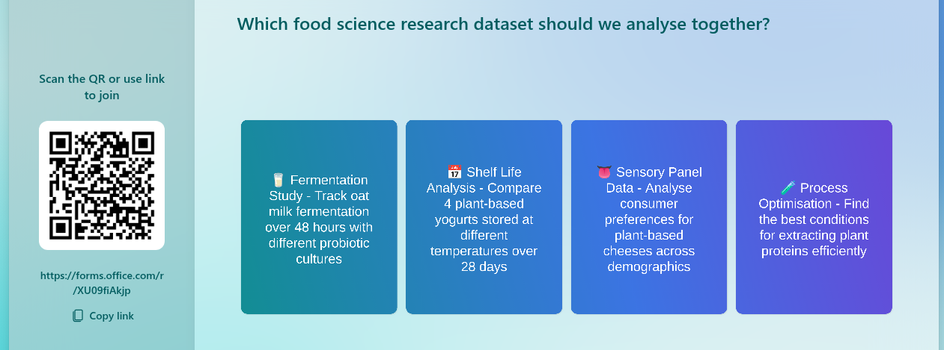
🗳️ Vote Now!

Slide 26
Quick Demo: Bad vs. Good Prompting 🎯
Let’s try both approaches…
First: The “Everything” Prompt (3 min)
Watch what happens when we ask for too much at once
“Analyze [winning dataset], create graphs, write conclusions, and suggest future research”
Then: Our Structured Approach (7 min)
See the difference when we break it down
Steps 1 → 3 → 7 in sequence
Pay attention to: Response quality, detail level, and actionability​

Slide 27
Troubleshooting Common Issues 🔧
Problem: AI gives generic responses
Solution: Add more specific requirements to your prompt
Problem: Getting confused by long conversations
Solution: Start a new chat session
Problem: AI refuses to help
Solution: Rephrase more academically, avoid trigger words
Universal fix: When stuck, start fresh with a clearer, more specific prompt

Slide 28
Understanding AI Limitations ⚠️
Critical Things to Know
Hallucinations
- AI can “make up” information
- Fake citations are common
- Always verify sources
- May invent plausible-sounding data
Other Limitations
- Knowledge cutoff dates
- Can’t access real databases
- No actual lab work
- Context window limits

Slide 29
Golden Rule for Research
Never trust, always verify! Use AI for ideation and structure, but validate all facts, citations, and data.

Slide 30
Key Takeaways 🎓
One Task, One Prompt - Your golden rule
Structure = Success - Guide the AI step-by-step
Iterate & Refine - Fix what needs fixing
Think Like a Manager - You’re the boss!
Always Verify - AI assists, you validate
Next Session Preview 👀
Hands-on practice with all 10 steps
Building your own AI research agent
Advanced techniques and shortcuts
Bring a research topic you’re curious about!

Slide 31
Your Mission (Should You Choose to Accept) 🎯
Before Next Session:
Think of a research topic you’re interested in
Try the idea generation prompt on your own
Note what works and what doesn’t
Bookmark copilot.microsoft.com or your preferred AI tool

Slide 32
Remember
You’re not learning to use AI - you’re learning to manage AI

Slide 33

Questions?
Let’s Discuss!
Concerns about the workflow?
Technical questions?
Want to see another demo?
Ethical considerations?

Slide 34
Resources & Links 📚
Everything You Need
Presentation slides
All datasets
Audio version
Video explainer
Quick reference
Created with assistance from Claude (Anthropic)

